Slide 1




Youth (un)employment and NEETs before and during the Covid-19 pandemic
International research seminar, Budapest Institute, May 12 2022
Sarah Kups, Labour Market Economist
Directorate for Employment, Labour and Social Affairs
@OECD_Social

Slide 2
Agenda
Youth (un)employment and the pandemic
Initial and recent developments in youth unemployment
Country, EU and OECD reactions
The OECD’s changing role in supporting country actions
2013+: Analysis of country NEET situation and policies
2020+: Increased implementation and evaluation support
Notes:
With my presentation today, I am hoping to first set the scene a bit on the current labour market challenges we are seeing for young people across the OECD and in the central and eastern European OECD countries in particular, but also to discuss what actions our member countries have taken to basically not have a repeat of what happened to youth employment in the aftermath of the Global Financial Crisis.
After this scene-setting part, I would then like to explain a little bit about how the work of the OECD youth team (which is housed in the social policy division of the Directorate of Employment, Labour and Social Affairs) has evolved over the past decade, and raise some of the areas in which we are always looking for more empirical evidence.

Slide 3
Youth (un)employment and the pandemic

Slide 4
An initial surge in youth unemployment
The unemployment rate among 15-29 year-olds reached 11.5% in the last quarter of 2020, compared to 7.5% for the total population
The NEET rate increased by 1 pp in 2020, initially mostly inactive, then unemployed
Notes:
Young people have been particularly affected by the economic crisis. They were often working in sectors that are hit hard by the pandemic, like accommodation, food services and retail trade, and they often worked on temporary contracts. In addition, hiring was very limited, so both new graduates and young people’s whose (temporary) contract ended during the crisis could not find a new job.
As a result, youth unemployment rates went upwards in all OECD countries and the weighted average OECD unemployment rate reached 16.6% among 15-29 year olds at the height of the crisis, nearly double the pre-crisis rate [8.6%]. The strong increase has mainly been driven by Canada and the US, but for several EU and LAC countries, the increase, even if minor, comes on top of structurally high youth unemployment.
The rate of those not in employment, education or training (NEETs) also increased at the start of the pandemic, reversing the trend of the past decade, and at the end of 2020, there were almost 3 million more young NEETs across the OECD compared to one year before. There was initially a strong increase in inactive NEETs, but that trend changed later on when many young NEETs returned to active job search.

Slide 5
Job loss as a large part of the drop in hours
Decomposition of percentage change in hours worked by age group
%
Joblessness (inactive and unemployed) 0-hours employment
Reduced working hours Total change in hours
Notes:
Looking at the impact of the crisis is by looking at the hours worked provides us with a different angle. This chart clearly shows that the hours worked by young people fell by much more than those of prime-age and older workers. Whereas for prime-age and older workers, the reduction in hours worked was primarily in the form of reduced hours, but for young people, the adjustment came largely through inactivity and unemployment.
This difference is likely to have implications for the speed of the labour market recovery among young people, as they cannot simply return to their previous employer. This effect was already visible in the third and fourth quarter of 2020, when the number of hours worked for prime-aged and older workers largely recovered, while jobless young people remained largely unemployed or inactive.
And while it goes without saying, the impact of the COVID-19 crisis goes far beyond employment for young people too. That includes education, but also when thinking about the broader social and health impacts.
For example, young people’s mental health has been heavily affected during the COVID-19 crisis throughout the OECD countries where data is available. Here you can see data from July 2021, which shows that across countries where data is available, prevalence of symptoms of anxiety and depression have remained higher among young people than other age groups. And in most countries, this higher prevalence among young people is a new development, and did not exist prior to the crisis.

Slide 6
Youth employment recovery across the OECD
EU-27
OECD
Across the OECD and the EU, the unemployment rate among 15-24 year olds at the end of 2021 was below the rate observed at the end of 2019.
Employment rates were restored to pre-pandemic levels.
Source: OECD.Stat

Slide 7
NEET rates prior to the pandemic
Share of 15-29 year olds neither in employment, education or training, 2019
Notes:
But these are the averages – let’s look now specifically at what has been happening in Central and Eastern Europe
In this figure we have the pre-pandemic NEET rates, from 2019
You can see that within the range of OECD countries, NEET rates in CEE range from what I would call the ‘low to high’ middle, with Slovenia having the lowest and Romania the highest NEET rates overall. This puts countries in the region above more Northern European countries, but below the rates that we see in Southern Europe, Latin America and Turkey
In some of these countries, the share of unemployed to overall NEETs is higher than is typical – for example in Slovenia and Croatia, the share is above the cross-country average of 35%. But in others, sucha as the Czech Republic and Bulgaria, it is substantially lower. The reasons for the differences can differ and depend on factors such the profile of the NEETs and the policy environment. But a higher inactivity share can it make more difficult to reactivate NEETs or even identify them in the first place

Slide 8
A less pronounced recovery in CEE
In the Central and Eastern European OECD countries, with the exception of Lithuania, the unemployment rate for youth was higher in the fourth quarter of 2021 than two years prior.
The NEET rate (Q3) decreased by 1.3 percentage points, but increased in twelve
Source: OECD.Stat
Notes:
For the Central and Eastern European OECD countries, the picture is unfortunately slightly less rosy, though with the exception of Estonia likely also less dramatic than we might initially have feared at the outset of the pandemic.
Here, we have plotted the difference in the unemployment rate for 15-24 year olds of the second quarter of 2020 and of the fourth quarter of 2021 to the fourth quarter of 2019. On average across the OECD, the second quarter of 2020 saw the largest youth unemployment rate during the pandemic, though in some countries the peak actually happened later, in the third or fourth quarter.
The dark blue shows the initial increase in percentage points. We can see that across the OECD, the EU and all the CEE countries, this increase was positive, meaning that youth unemployment went up over this period.
The light blue shows the change between the same fourth quarter of 2019 and the fourth quarter of 2021. As we saw already in the prior slide, across the OECD and the EU, youth unemployment rates actually slightly declined when we compare these two points in time. In CEE, however, the situation is different: Only in Lithuania was the same decline observed. In all the other countries, youth unemployment at the end of 2021 was higher than at the end of 2019.
EXPLANATION CEE
Estonia already had quite important swings in the youth unemployment rate prior to Covid-19, for example from 8% in the first quarter of 2019 to 18% a quarter late and 14% a quarter after that. EXPLANATION
OTHER COUNTRIES THAT SAW INCREASE (above one percentage point): Colombia, Costa Rica, Luxembourg, Norway, Sweden.
Between the third quarter of 2019 and 2021, across the OECD, the NEET rate decreased by 1.3 percentage points, but it decreased in 17 and increased in 11 countries. The countries where it decreased include Latvia, Slovenia and the Slovak Republic, and increased in Estonia, Lithuania, Poland, the Czech Republic. In the countries that had the largest change, the bulk of the change came about through changes in inactive rather than unemployed populations.
Across the EU-27, the NEET rate for 15-24 year olds increased by 0.9p.p. from 2019 to 2021. The increases were more pronounced in some CEE countries (Estonia, Lithuania, Poland, Romania) though not in Bulgaria, the Czech Republic, Croatia, Latvia, or there were even decreases (Hungary, Slovenia, Slovak Republic)

Slide 9
Young people are returning to education
Youth (15-29) changes in education and employment, 2019-21
In all CEE OECD member or accession countries except Lithuania, the share of youth in education increased between 2019 and 2021
But in the Czech Republic, Estonia, Croatia, Latvia, Lithuania, Poland and Romania, the increase was not large enough to offset drops in employment
Source: Eurostat
Notes:
Here we plotted the changes in the education and in the employment rates for 15 to 29 year olds between 2019 and 2021 for EU countries. The employment rate change refers to the share of young people who are not in either formal or informal education, so below the official employment rate for the age group that also includes young people who simultaneously work and are in education.
The way to read this graph is that in countries above the diagonal, the sum of the change in 15-29 year olds in education and who are employed but not currently in education is positive, meaning that these are countries in which the NEET rate for this age group is falling. For countries below the diagonal, the opposite is true. Please note that I pulled this figure together last week based on the newly released Eurostat data, and that unfortunately in 2021 there were breaks in the data series in a majority of included countries. We haven’t yet had a chance to adjust for the definitional changes, so that this figure is still very much preliminary and should be taken with a grain of salt.
That being said, we can that most coutnries are pretty close to the diagonal, meaning that their changes in the NEET rate are not drastic.
We can also see that the majority of countries lie above the x-y axis intersection, meaning that the share of young people who are enrolled in formal and informal education has risen between 2019 and 2021.
A priori, it wasn’t evident that this would happen. On the one hand, we know that in times of economic crisis, young people often choose to stay longer or return to education than they might have had in a more favourable economic environment. On the other hand, we were also concerned that due to a decline in in-person instruction, more young people would drop out of school; and students might have been less inclined to stay at university if they had to follow courses online or had to fear infecting vulnerable relatives they were living with during in-person instruction.
But at least for most European countries, that fear does not have seemed to have translated in drops in educational participation (with the strong exception of Switzerland
In all CEE OECD member or accession countries except Lithuania, the share of youth in education increased between 2019 and 2021
But in the Czech Republic, Estonia, Croatia, Latvia, Poland and Romania, the increase was not large enough to offset drops in employment

Slide 10
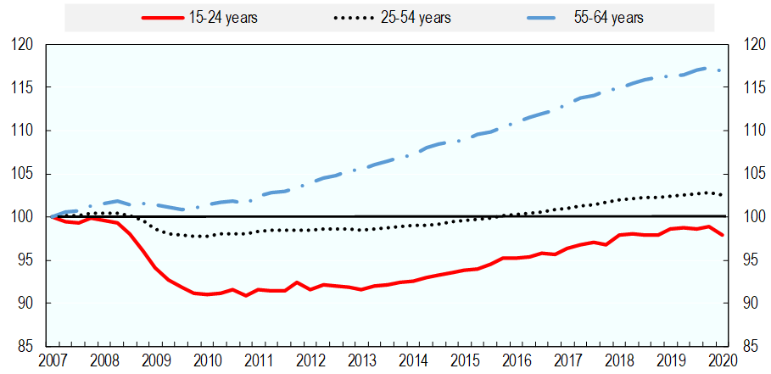
Learning the lessons from the global financial crisis
OECD average employment rates 2007 Q1 – 2020 Q1 (2007Q1 = 100%)
Source: OECD.Stat
Notes:
Part of the reason why we were really concerned about the impact of the pandemicon youth employment is that we know from the global financial crisis that a labour market crisis can have long-term consequences on young people’s labour market outcomes.
As you can see in the chart, it took more than a decade for the youth employment rate to recover from the global financial crisis. To some extent this might show that young people are studying longer, but the unemployment rate has followed a similar trend.

Slide 11
Learning the lessons from the global financial crisis
OECD average employment rates 2007 Q1 – 2020 Q1 (2007Q1 = 100%)
EU: Youth Guarantee recommendation
OECD: Action Plan for Youth
Source: OECD.Stat
Notes:
After the last crisis, the support took a long time to arrive.
Though there had been discussions in the European institutions to follow the example of in particular some Nordic countries to establish a youth guarantee already from the mid-to-late naughts onwards, the actual establishment of a Youth Guarantee took a while. In September 2010, the Youth on the Move initiative included an appeal to the member states to offer an opportunity to young people within four months of finishing their studies. But it was only in December 2012 that the Commission launched a youth employment package that included a proposal for a Council Recommendation on the establishment of a youth guarantee, which set out the principal elements of the youth guarantee and specified the mechanisms that the EC would use to support the establishment of the guarantee in the member states.
In April 2013, the council adopted the proposal as a recommendation to member states, and throughout the year, financing from the EU side was set in place.
At the OECD as well, Ministers adopted the OECD Action Plan for Youth in May 2013.

Slide 12
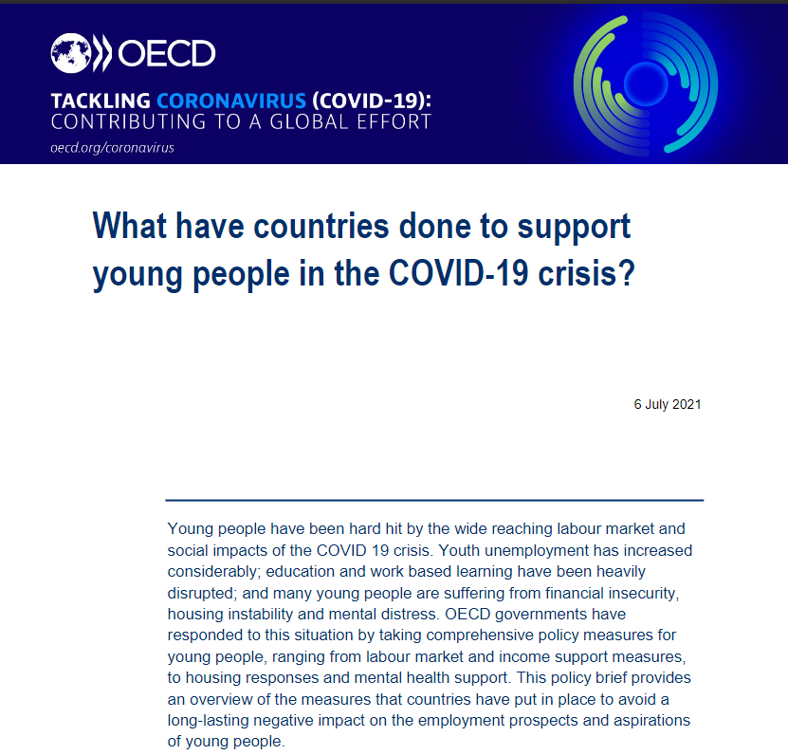
Countries reacted quickly to the pandemic
Notes:
Recognising the need for rapid action, most OECD governments included in their emergency support packages a range of measures specifically targeted at young people).
Now what we found was that labour market measures were widely deployed across OECD countries. 30 countries strengthened work-based learning, 13 introduced or extended youth hiring subsidies (out of 23 that now have it overall), and most bolstered employment support and services for young people, including for example outreach, employment support, and training for digital skills.
By comparison, policy responses beyond labour market interventions have been less comprehensive.
Over half of OECD countries did introduce some form of emergency income support, recognising the increased risk of financial insecurity among young people during the COVID-19 crisis, but measures taken varied in scale and reach.
A notable and emerging trend to come out of the COVID-19 crisis has been a focus of countries on providing income support for students who are reliant on part-time work or summer jobs to fund their education and living costs. In at least 11 countries, measures have been taken to support this group.
Over half of OECD countries have also strengthened mental health support for young people, but often the increase in funding and availability of services has been moderate and unable to match the increased demand. In Norway, for example, a new action plan on children and young people’s mental health was released earlier this year with funding for hotlines, schools, health services but also employment services specifically on mental health.
Last but not least, housing. Here we found measures taken may have benefitted young people, but few measures were specific to this age group.
Backup notes:
France is a notable example of a country that has implemented a wide range of measures to promote better labour market outcomes of young people. France has actually managed to increase the number of apprenticeship enrolments during COVID-19, in part due to financial incentives to recruit apprentices, but also combined this with temporary hiring subsidies, as well as targeted employment support and training for young people at risk of disengagement and in vulnerable circumstances.
in Japan, for example, emergency handouts were provided both to students directly, but also to universities to support students experiencing financial hardship.
In Norway, for example, a new action plan on children and young people’s mental health was released earlier this year with funding for hotlines, schools, health services but also employment services specifically on mental health.

Slide 13

The EU and OECD also reacted more swiftly
EU Reinforced Youth Guarantee
Adopted by the Council in October 2020
Extending YG to 25 to 29 year olds (as already practiced in many countries)
Called for improved support for long-term NEETs; mapping of target groups; strengthening early intervention and post-placement support
Updated OECD Youth Action Plan
In the 2020 Ministerial Council Statement, Ministers welcomed the OECD updating its Youth Action Plan
On 31 May 2021, Ministers welcomed the Updated OECD Youth Action Plan:
  A short overview of the key issues that young people were facing
  List of policy actions taken by countries to support young people
  Actions the OECD Secretariat could undertake to help countries promoting better outcomes for young people
Notes:
The European Social Fund Plus (ESF+), with a budget of €99 billion, will be a key EU financial resource to support the implementation of the Youth Guarantee in the 2021-2027 EU budget.
All Member States will have to invest an appropriate amount of their ESF+ resources in targeted actions and structural reforms to support youth employment, education and training. Member States with a higher rate than the EU average of NEETs should devote at least 12.5% of their ESF+ resources to these measures.
As OECD economies bounced back from the initial COVID-19 shock and labour market outcomes improved, also youth unemployment rates returned to their pre-crisis levels in many OECD countries). In the context of these encouraging developments, however, it is important not to lose sight of those young people most heavily affected by the crisis. This group includes the cohort of young people who entered the labour market during the crisis; young NEETs who are not registered with public employment or social assistance services (the so-called “hidden NEETs”); students with insufficient financial means; and young people experiencing poor mental health. As highlighted in the Updated OECD Youth Action Plan (OECD, 2021_{[41]}), they will require additional support to avoid long-lasting scars on their careers and life outcomes.

Slide 14
The OECD’s changing role in supporting country actions

Slide 15

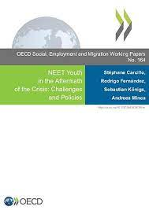



Since the GFC: (Cross-)country analyses on NEET profiles and policies
Investing in Youth reviews
Builds on the OECD expertise on youth employment, social support and skills
Structured around the profile of NEETs and policy actions
Since 2014, reports for 12 OECD and emerging countries
Notes:
The Investing in Youth reviews analyse the employment and education situation of young people in the country. They provide a detailed assessment of the education, employment and social policies in the respective from an international perspective, and offers tailored recommendations to help improve the school-to-work transition both in terms of policies that can help prevent young people from becoming NEETs and interventions to support young people who are already inactive.
We based the analysis on in-depth literature reviews, the analysis of labour force and household surveys and (in the case of Slovenia) administrative data. A key step in the analysis were the country missions, during which we meet with key stakeholders in different ministries, in particular the ministries for labour, social affairs and education, any youth agencies (if they exist), as well as youth organisations, trade unions and employer representatives, public employment agencies, researchers etc.
. As the secretariat of an international organization, we ourselves are producers of research (as well as statistics), but we are above all huge consumers and ‘re-packagers’ of research. We know that the senior civil servants and other policy makers are usually too busy with their day-to-day work to seek out the original research themselves. We hope that through our work we are able to distil important research results for them.
Since 2013, there have been 13 reports on OECD and partner countries: Australia, Brazil, Finland, Japan, Korea, Latvia, Lithuania, Norway, Peru, Sweden, Slovenia and Tunisia.
Since the Slovenian review is the one that we completed most recently, and it is relevant to this region, I am going to be presenting a few selected results and recommendations from this particular review. I hope they illustrate both what type of work we are doing, but most importantly what areas our ministry partners are often most concerned about. For the Slovenian project in particular, which was funded by the EU’s Structural Reform Support Service (now DG-REFORM), our interactions with the ministry were even tighter then usual, and we benefitted from in-depth feedback not only from our partner but also other ministries

Slide 16




Who are NEETs?
Low educational attainment
    1/3 of all NEETs have not completed high school
Childcare responsibilities
    Women are 4x more likely to be NEET if they have small children
Ill health
    The incidence of poor health is 5x higher for NEETs
Intergenerational disadvantage
    NEETs’ parents 2x as likely to have low educational attainment or to be workless
Source: OECD (2016), The NEET challenge?, in Society at a Glance 2016
Notes:
The first question that we always sought to answer in the reports was who the NEETs were. This may appear like an obvious step, but we have seen that there can be surprises, such as senior civil servants in one ministry being surprised just how much being a single mother increased the NEET probability, and deducing that they wanted to focus more on this group going forward.
The statistics that I am citing here stem from our 2016 youth focus chapter in the flagship publication Society at a Glance. The details have evolved since then, but the main messages still stand.
For many young people, the impact of a labour market crisis will only be temporary, but many others, and in particular disadvantaged young people, face an increased risk of high and persistent unemployment, poor quality jobs when they do find work, and a high risk of social exclusion. Specific attention to these groups is needed to ensure they receive the support they need to thrive in life.
So, let’s now zoom in on the group of young people who are neither in employment, education or training; a group that is at a high risk of long-term labour market exclusion.
NEETs tend to have low educational attainment, childcare responsibilities, ill-health or intergenerational disadvantages. For instance, 1/3 of all NEETs have not completed high school. Women are 4 times more likely to be NEET if they have small children. The incidence of poor health is 5 times higher for NEETs. NEETs’ parents twice as likely to have low educational attainment or to be workless.

Slide 17
Skill gap between NEETs and employed youth
Percentage difference in skills between NEETs and employed youth, 16-29 year olds, 2012
Source: OECD (2015), OECD Skills Outlook 2015,
http://dx.doi.org/10.1787/9789264234178-en
Notes:
The Survey of Adult Skills shows that in all countries covered, young NEETs have lower cognitive skills than employed youth (Figure 5.1). Yet on average per
country, the gap in literacy and problem-solving skills is not excessively high (and close to 0 in Korea and Japan) although this hides some heterogeneity between individuals. The NEETs may also lack some other employability skills.

Slide 18
One in two older youth in Slovenia who did not complete school are NEETs
Create transition programmes, flexible catch-up programmes, mentorship programmes for Roma students
Encourage involvement of migrant and Roma parents, extend the Roma teacher assistant programme, etc.
Establish clear responsibilities for tracking and contacting early school leavers
Consider raising the mandatory participation age to 18 for students who have not yet attained an upper secondary degree
Source: OECD (2021), Investing in Youth: Slovenia - http://oe.cd/youth-slovenia
Notes:
Most young Slovenians graduate from upper secondary school, but those who do not are at a much higher risk of becoming and remaining NEETs.
Indeed, our analysis shows that nearly one in two older youth (in the age category 25-29) who did not complete school are NEETs in Slovenia.
School dropout is more common among certain groups of adolescents, including Roma youth, immigrants and children of immigrants, and youth attending short vocational programmes.
Slovenia already has a strong education system that leads most students to an upper-secondary degree and a relatively smooth transition into the labour market.
However, a few additional measures to address the sources of academic difficulties and prevent early school leaving could help to keep the highest-risk students in school
Range of recommendations: transition programmes, flexible catch-up programmes, mentorship, etc. – more details in the report.

Slide 19
Half of all NEETs are long-term NEETs
Distribution of NEETs by duration, average over the period 2014-2017
Source: OECD (2021), Investing in Youth: Slovenia - http://oe.cd/youth-slovenia
Notes:
Many young people go through short NEET spells without major repercussions on their well-being and future economic opportunities. For example, recent graduates may take a few months to search for a job without future employers thinking any less of them. In contrast, being a NEET for a longer period can adverse effects on a young person’s well-being and ability to complete further studies or find a job. It is therefore important to look in more detail at the length of NEET spells.
On average across 18 EU countries, half of all NEETs aged 15-29 remain inactive or unemployed for more than a year. The share of long-term NEETs is particularly large among the older youth cohort. Two out of three 25-29 year olds are long-term NEETs, making it very hard to reactivate them. In the mid-2010s, the share of long-term NEETs was above average in the CEE OECD countries, with the largest share in Lithuania. However, the share was still lower than in some southern European countries, notably Spain and particularly Greece.

Slide 20
Employment services need to strengthen outreach to NEETs
Share of NEETs aged 15-29 who registered with the public employment service in 2008 and 2019
Notes:
Young people who are unemployed or inactive can contact employment services on their own initiative, for instance, when they are looking for support in finding a job or when they want to claim their unemployment benefits. However, not all NEETs will reach out to the employment services, and that for a variety of reasons: they are not entitled to income support; they are not aware of the support they can receive; they lack trust in public authorities; or they are simply not looking for a job.
Despite the Youth Guarantee initiative in EU countries and the strong attention devoted to young people’s labour market integration, barely 38% of all NEETs were registered with the public employment services in 2019. Among unemployed youth, the share is not much higher: only 56% of unemployed youth are registered with the public employment services.
To improve the activation of NEETs and reduce inactivity and unemployment among young people, it is important to improve outreach to these NEETs. But to do so, we need to better understand who does not reach out for support and why.

Slide 21
The hidden NEETs of Slovenia
  53% of NEETs in Slovenia are not registered with the ESS
      58% are 25-29 years old
      90% have no work experience
      75% are inactive
      2.4 years is their average NEET spell
      46% have never been in contact with the ESS
Motives behind the NEET status
% of all unregistered NEETs in Slovenia, 2018
(Findings based on administrative data for Slovenia, 2011-2018)
Source: OECD (2021), Investing in Youth: Slovenia - http://oe.cd/youth-slovenia
Notes:
For our project with Slovenia, we were fortunate enough to have access to a large administrative database with anonymised data for all young people in Slovenia. This data allowed us to take a closer look at the group of unregistered NEETs.
Our analysis revealed that 53% of all NEETs in Slovenia do not register with the public employment service of Slovenia. Most of them are 25 to 29 years old, have no work experience, are inactive The figure on the right hand side shows that family responsibility, illness and informal education are important motives for inactivity among unregistered NEETs.
However, half of this group has been in contact with the ESS at some point in their career, which suggests that there is certainly room to improve the support that the public employment service offers to young jobseekers.

Slide 22
Slovenia devotes relatively few resources to labour market programmes
Expenditure (EUR) per registered jobseeker on labour market programmes in EU countries, 2018
Modernise and streamline practices at the ESS towards a digital, lean service delivery to free up resources for young people who need more support
Prioritise the introduction of a statistical profiling tool
Tailor employment services and programmes more efficiently to those youngsters who need it
Increase the resources for mental health support at the ESS, in order to increase internal mental health competences
Expand the network connections with the mental health sector
Source: OECD (2021), Investing in Youth: Slovenia - http://oe.cd/youth-slovenia
Notes:
Support for young jobseekers who reach out to the Employment Service of Slovenia improved over the past couple of years, through the implementation of the Youth Guarantee, the hiring of youth counsellors at the offices of the Employment Service of Slovenia and a range of active labour market programmes for long-term unemployed youth.
However, Slovenia still devotes relatively few resources to labour market programmes compared with other OECD countries and the choice of programmes heavily depends on available funding. We also noted that long-term unemployed systematically receive less employment services during their first four months of unemployment than short-term unemployed youth.
The Covid-19 crisis further affected service delivery of the Employment Service of Slovenia, as caseloads rose and the digital services required for social distancing are still underdeveloped. The ESS is developing ways to organise counselling services via video calls and increase the number of young people they can reach per day.
However, additional structural changes are needed to streamline and digitalise service delivery and help young jobseekers find their way (back) to the labour market.

Slide 23
Examples of support for M&E
  JOBLINGE programme evaluation
  basecamp: an innovative learning space for young apprentices
  ‘Classic’ programme evaluation with semi-structured interviews, focus groups and surveys
  An M&E plan for the Spanish Youth Guarantee Plus Plan (YG+) 2021-2027
  Objectives include recovering quality of youth employment, reduce gender employment gap and youth unemployment through 69 measures across six work streams
  OECD collaborates with PES to design the M&E framework
  Italy’s youth volunteering service & Ireland’s whole-of-government policies for young people
  Support in monitoring the policies
Notes:
Aside from this ‘traditional’ analytical work, we are finding that the Youth Team is increasingly solicited for evaluation and implementation support.
One project that we are currently implementing is an evaluation of a youth labour market integration project in Germany
Another is the development of a M&E plan for the Spanish Youth Guarantee+ plan for the upcoming six years. The YG+ plan was approved last year and includes 69 measures across six work streams, including

Slide 24
Examples of support for implementation
  NEET prevention strategies for Australian lower secondary students
  Analysis of international good practices and suggestions for their applicability in the Australian context
  Assessment of needed changes to data and evaluation system
  Personalised services for vulnerable groups in Lithuania
  Lithuania wants to offer more tailored social and labour market services to vulnerable groups, including youth who were formerly in out-of-home care
  Analysis of current services and benefits available and creation of a roadmap to create a more unified system

Slide 25
Examples of areas of needed evidence
  Development of employment and NEET rates
  Policy, economic and structural factors associated with youth labour market outcomes across countries
  NEET prevention
  Medium- and long-term impacts of career education and guidance
  Impact of programmes to support young parents
  NEET activation
  Impacts of tailoring of support measures
  Ensuring sustained integration into the labour market

Slide 26
Thank you for your attention
sarah.kups@oecd.org

